Slide 1
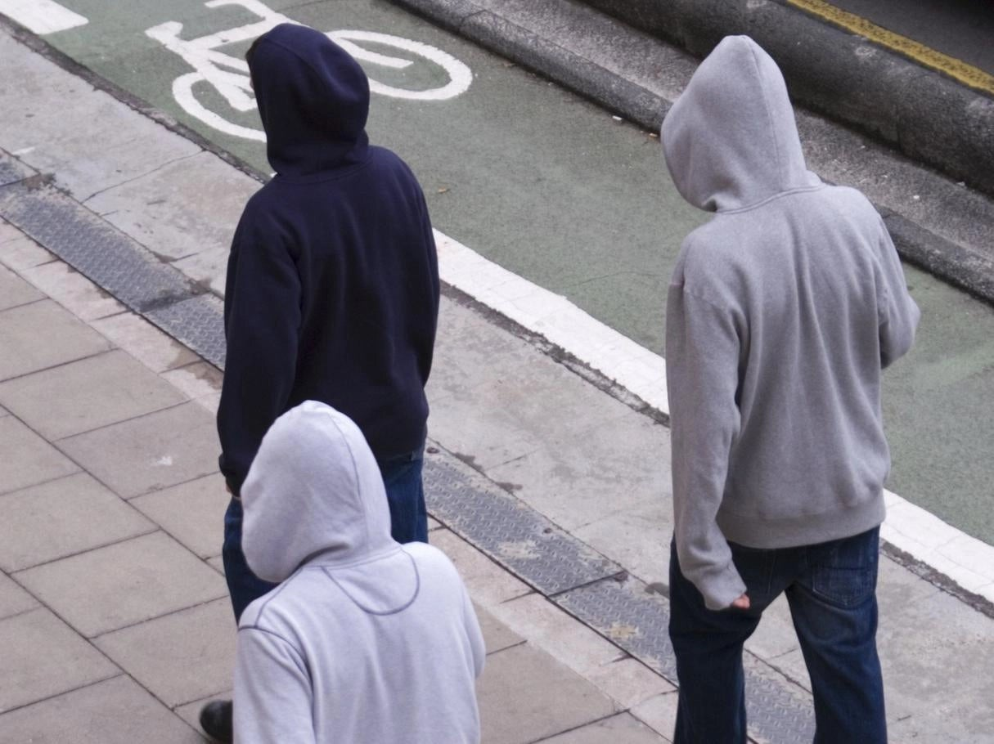
Trends in youth offending in Queensland Dr Molly McCarthy Griffith Criminology Institute

Slide 2
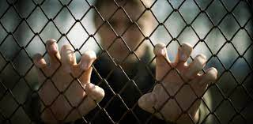
Trends in youth offending
Overview
Recent trends in youth offending in Queensland
Chronic offenders – characteristics and offending trajectories
Chronic offenders – types of offences
Youth offending during COVID-19

Slide 3
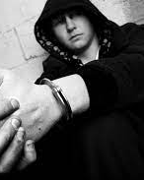
Trends in youth offending internationally
The number of youth offenders has been declining across a broad range of international jurisdictions over the last 20-30 years (U.K., U.S., European countries)^{1,2,3}
Drivers of decline assumed to include:^{4,5}
Increased securitisation of property
Proliferation of internet and smart phones – young people spend more time indoors and under parental supervision than previously
Changes to social norms, antisocial behaviour and aggression less acceptable, more formal sanctions
Limited analysis to date suggests the decline is in the number of young people engaged in adolescent-limited offending rather than persistent offending³

Slide 4
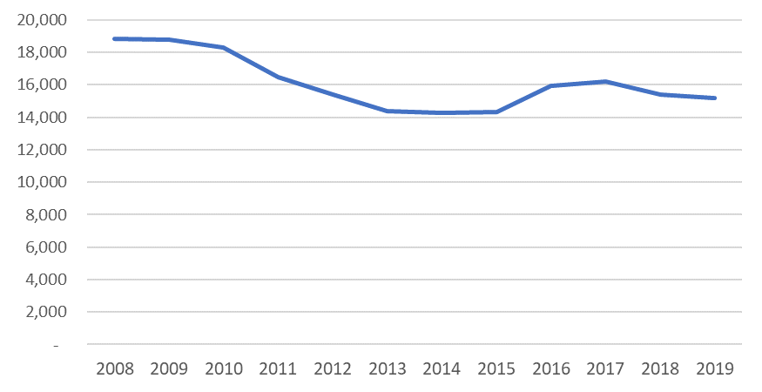
Trends in youth offending in Queensland
Decline in number of young people recorded for offences in QLD over past decade
Source: QPS QPRIME data extracted from Griffith University Social Analytics Lab; recorded offences for young people aged 10 to 17 years at time of offence
Notes:
Decline in the number of unique youth offenders recorded in each year from 18,819 to15,163, decrease in 3656 in number of young people recorded for offending from 2008 to 2019

Slide 5
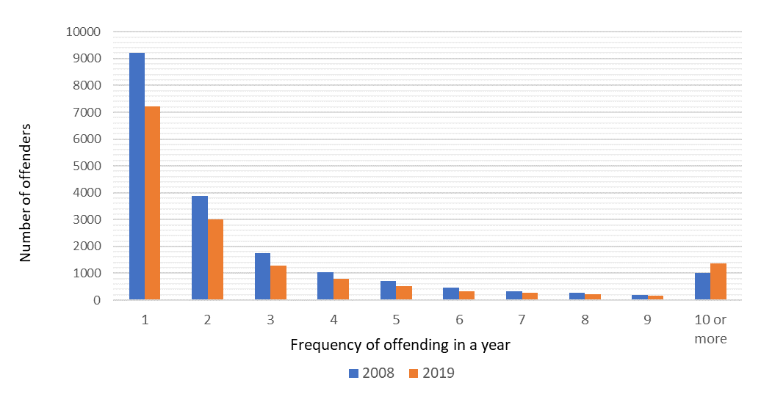
Trends in youth offending in Queensland
Decline is primarily comprised of young people recorded for one to three offences in a year
Young people recorded for 10 or more offences in year is only group increasing
Notes:
Increase in around 350 to 450 chronic offenders (individuals that offend 10 or more times in a year) from 2008 to 2018/19; decline in 4024 low to moderate offenders in the same period.

Slide 6
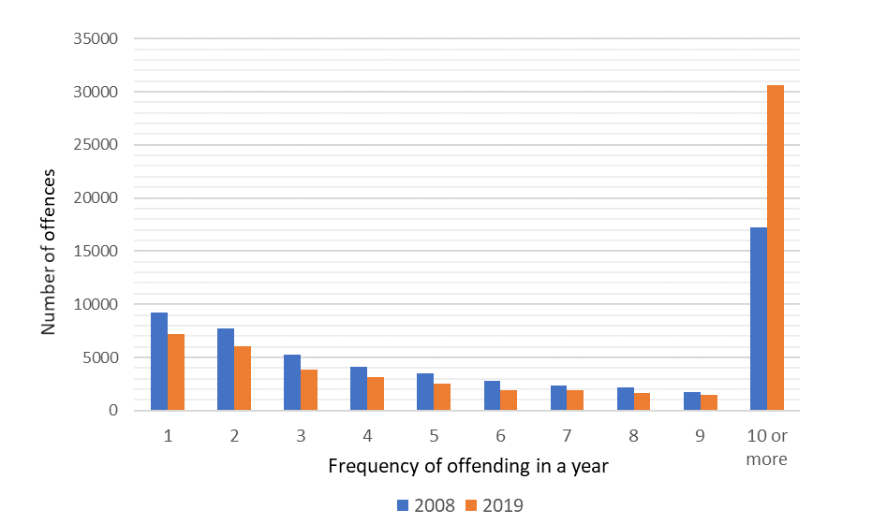
Trends in youth offending in Queensland
However, growth in a small number of chronic offenders has translated in a notable growth in offences
Overall number of youth offences in QLD have not changed significantly due to this (excepting during COVID-19 lockdown period)
Notes:
Increase in 13416 offences by chronic offenders from 2008 to 2019; decline in offences by one off or low to moderate offenders of 8970

Slide 7
Chronic offenders: characteristics and trajectories
Some indication that other national and international jurisdictions experiencing increased offending frequency among remaining youth offenders
Chronic offenders are characterised by: ^{6,7,8}
Backgrounds of disadvantage/poverty
Disengagement from school
Diagnosed or undiagnosed cognitive deficits or impairments
Experiences of poor parental attachment, abuse, neglect or trauma
In QLD, disproportionate concentration in regional/remote areas and among Indigenous young people
Growth in chronic offenders could be due to:^{5,9}
Growth in economic inequality (post GFC) - increased motivation for offending among young people in low SES communities
Increased concentration of police resources in low SES communities - increased surveillance, charging and churn of low SES young people through the CJ system
Increased population growth in low SES communities

Slide 8
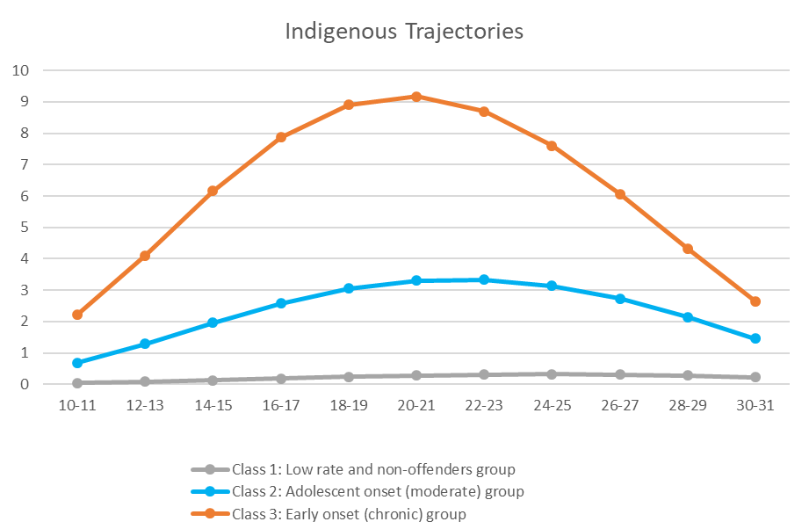
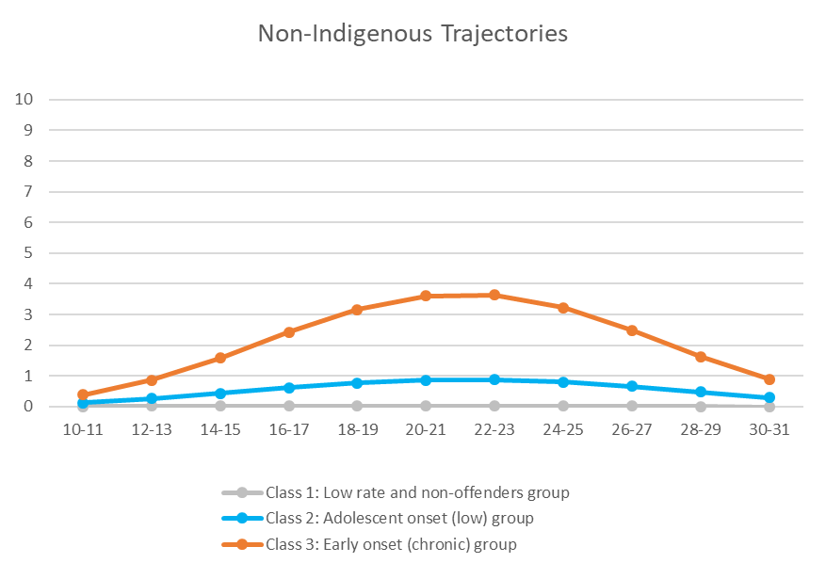
Chronic offenders: characteristics and trajectories
Offending trajectories for chronic offenders; based on a birth cohort born in QLD 1983/84
Linked CJ system data on convictions and diversions used to estimate offending trajectories from 10 to 31 years (Allard, McCarthy & Stewart, 2020)
Notes:
Indigenous chronic offenders start younger, and are convicted of a larger number of offences over their adolescent years
Greater churn through the system – prompts questions about how we surveille, detect and provide criminal justice system responses to Indigenous young people
Also – the moderate offending group in the Indigenous cohort looks similar to the chronic offending group in the Non-Indigenous cohort, so a larger number of Indigenous young people could be characterised as chronic offenders

Slide 9
Chronic offenders: characteristics and trajectories
Between 74-80% of Indigenous cohort found guilty of an offence by age 31 compared to 24-25% of the non-Indigenous cohort
53% of the Indigenous cohort was classified as having a moderate to chronic offender trajectory compared to 16% of non-Indigenous cohort
15%
38%
2%
47%
14%
84%
Notes:
If we care about the over-representation of Indigenous people in the criminal justice system, we need to reconsider how we respond to these young people

Slide 10
Chronic offenders: characteristics and trajectories
 | Trajectory group | Individuals |  |  | Cost
 |  | N | % of Indigenous or non-Indigenous cohort | % of total cohort | Average Individual cost ($) | Total group cost ($) | % of Indigenous or non-Indigenous cost | % of total cost
Indigenous | Low rate and non-offenders | 1,070 | 46.6 | 1.3 | 2,980 | 3,188,345 | 1.7 | 0.7
 | Adolescent onset (moderate) | 878 | 38.3 | 1.1 | 57,806 | 50,753,239 | 27.3 | 11.1
 | Early onset (chronic) | 347 | 15.1 | 0.4 | 380,097 | 131,893,751 | 71 | 28.8
 | Total | 2,295 | 100 | 2.8 | 80,974 | 185,835,335 | 100 | 40.6
Non-Indigenous | Low rate and non-offenders | 67,954 | 83.8 | 81.5 | 267 | 18,112,599 | 6.7 | 4.0
 | Adolescent onset (low) | 11,029 | 13.6 | 13.2 | 8,783 | 96,868,753 | 35.7 | 21.2
 | Early onset (chronic) | 2,093 | 2.6 | 2.5 | 74,798 | 156,552,496 | 57.7 | 34.2
 | Total | 81,076 | 100 | 97.2 | 3,349 | 271,533,847 | 100 | 59.4
Notes:
We spend a lot of criminal justice resources on chronic offenders, and even more so on Indigenous chronic offenders ($380,097 over the years from 10 years to 31 years)
Higher values for Indigenous chronic offenders due to higher frequency of re-contact, more serious sanctions, and slightly higher rates of violent offences
There are better ways we could be spending public resources to prevent young people, particularly Indigenous young people, from becoming chronically involved in the criminal justice system

Slide 11
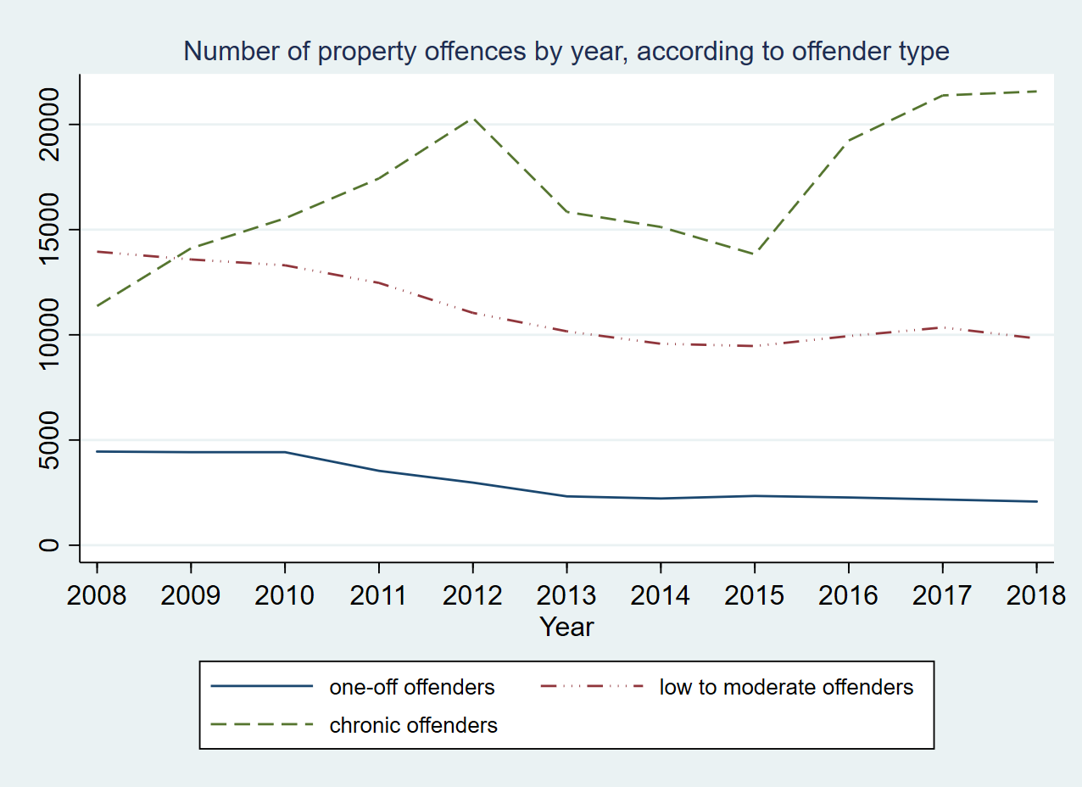
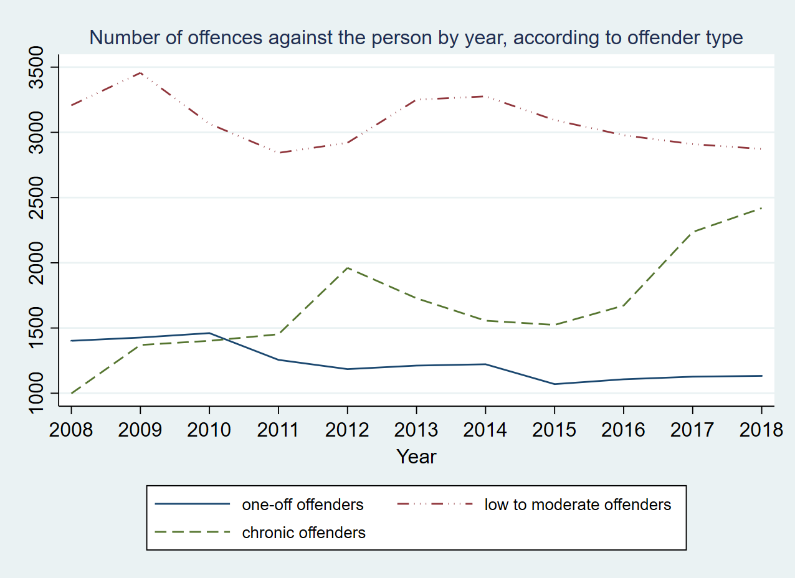
Chronic offenders: types of offences
Growth in offending by chronic offences is predominantly comprised of property offences (e.g. break and enter, burglary, theft) (McCarthy, 2020)
Some growth in violent offending, still lower than moderate offenders, likely to be a bi-product of offending lifestyle or incidental to property offending
Notes:
From 2008 to 2019 growth of approx. 10,000 in property offences by chronic offenders, and growth in 1500 in violent offences

Slide 12
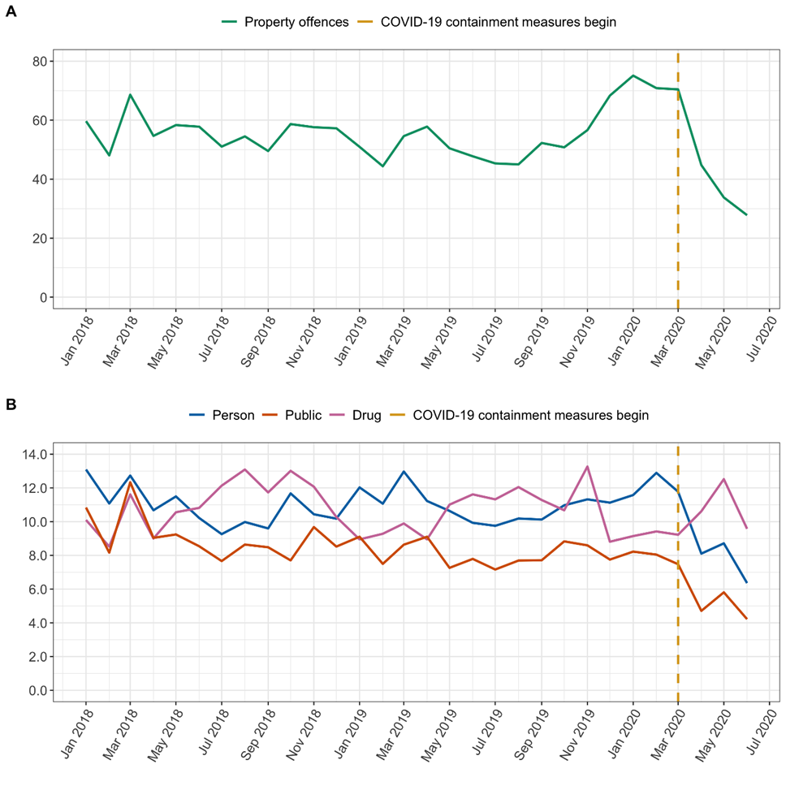
Impacts of COVID-19 on youth offending
Declines in youth property offending, violent offending and public order offending during April to June 2020 (McCarthy et al., 2021)
No change in drug offences
Notes:
So what happened to youth offending during COVID-19? Declines in property, violent and public order offences. In purple you can see that drug offences buck the declining trend, and were not significantly different during the first few months of the COVID-19 pandemic (Apr – Jun 2020).

Slide 13
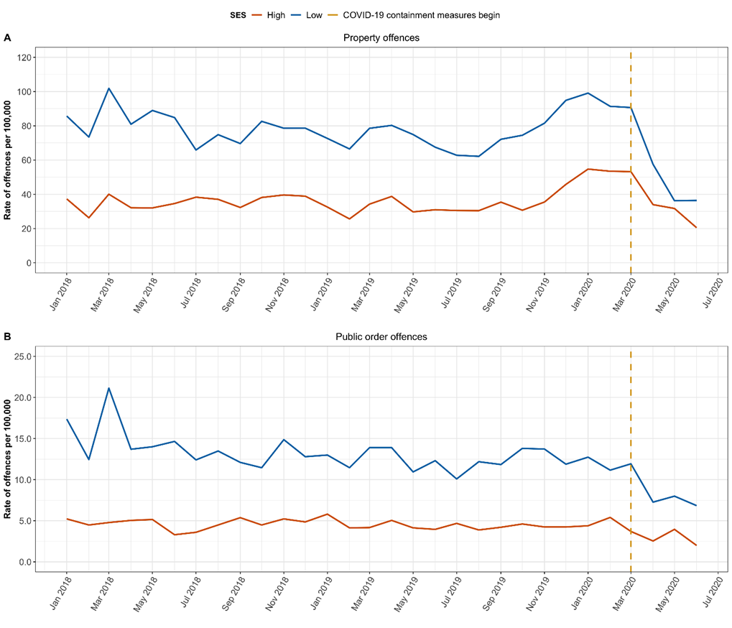
Impacts of COVID-19 on youth offending
Declines in youth property and public order offending were significantly greater in more disadvantaged areas
Suggests drivers of offending decline involved more than just changes in routine activities
Could this be the result of changes in other social, economic and policing responses?
Notes:
However, differences by SES of communities very interesting. Lower socio-economic communities showed significantly greater decline in youth property and public order offending than lower socio-economic communities
Suggests that there may have been influences on youth offending in addition to changes in routine activities, such as changes in economic responses and policing responses. So we know that Job Seeker supplement was argued to have reduced financial stress among the most economically disadvantaged families. Likewise, policing was diverted in part to COVID-19 related priorities, so visibility/detection of youth offending may have also reduced in this period.

Slide 14
Summary
Number of youth offenders in QLD declining, but there has been concurrent growth in chronic offenders
Chronic offenders come from backgrounds characterised by poverty, maltreatment, neglect, or trauma, disengagement from school, and often have cognitive deficits or impairments
Up to 53% of Indigenous young people may be engaged in moderate to chronic offending pathways; how we currently respond to Indigenous chronic offenders may detract from other efforts to close the gap
Traditional CJS responses to chronic Indigenous offenders very costly and ineffective at achieving desistance; tough on crime CJS responses likely to consolidate over-representation of Indigenous people in the adult CJS
Need to consider greater investment in prevention, early intervention and expanded diversionary pathways for Indigenous young people at risk and currently engaged in the CJS that can address the drivers of chronic offending

Slide 15
References
Tonry, M. (2014). Why crime rates are falling throughout the Western world. Crime & Justice, 43(1),1–63.86/67818
Weatherburn, D., Freeman, K., & Holmes, J. (2014). Young but no so restless: Trends in the age-specific rate of offending. Crime and Justice Statistics Bureau Brief Vol. 98. NSW Bureau of Crime Statistics and Research.bb98.pdf
Matthews, B., & Minton, J. (2018). Rethinking one of criminology’s ‘brute facts’: The age–crime curve and the crime drop in Scotland. European Journal of Criminology, 15(3), 296–320.
Payne, J., Brown, R., & Broadhurst, R. (2018). Where have all the young offenders gone? Examining changes in offending between two NSW birth cohorts. Trends & Issues in Crime and Criminal Justice, (No. 553).
McCarthy, M. (2020). How universal is the youth crime drop? Disentangling recent trends in youth offending through a socio-economic lens. Victims & Offenders. Advanced online publication, http://doi.org/10.1080/15564886.2020.1855281
Whitten, T., McGee, T. R., Homel, R., Farrington, D. P., & Ttofi, M. (2019). Comparing the criminal careers and childhood risk factors of persistent, chronic, and persistent–chronic offenders. Australian & New Zealand Journal of Criminology, 52(2), 151–173. https://doi.org/10.1177/0004865818781203
Wikstrom, P. H. & Trieber, K. (2016). Social disadvantage and crime: A criminological puzzle. American Behavioural Scientist, 60(10), 1232-1259.
Allard,T., Chrzanowski, A., & Stewart, A. (2012). Targeting crime prevention to reduce offending: Identifying communities that generate chronic and costly offenders.Trends and Issues in Criminal and Criminal Justice, no. 445
Nilsson, A., Estrada, F., & Bäckman, O. (2017). The unequal crime drop: Changes over time in the distribution of crime among individuals from different socioeconomic backgrounds. European Journal of Criminology, 14(5), 586–605ps://doi.org/10.1177/1477370816682979
Allard, T., McCarthy, M., & Stewart, A. (2020a). The costs of indigenous and non-indigenous offender trajectories. AIC Trends & issues in crime and criminal justice no. 594.
McCarthy, M., Homel, J., Olgivie, J. & Allard, T. (2021). Initial impacts of COVID-19 on youth offending: An exploration of differences across communities. Australian and New Zealand Journal of Criminology. Advanced online publication, https://doi.org/10.1177/00048658211005816

Slide 16
Questions?

